Slide 1


Green Pace
Security Policy Presentation
Developer: Jiayu Lin
Notes:
Hello, my name is Jiayu Lin. I will be presenting a new security policy for our company Green Pace as well as highlighting important security principles to adopt.

Slide 2

OVERVIEW: DEFENSE IN DEPTH
Important to protect our user data and the integrity of our company
Implementing core security principles through a policy
Defense in Depth is the practice of layering security mechanisms to create a more robust shield to defend against attacks.
Notes:
Security is critical to the entire operation. We must uphold the company’s integrity by protecting data that is trusted to us. This will be showcased in a security policy with guidelines of common vulnerabilities to watch for. This is all a practice of Defense in Depth where we will continue to layer defensive mechanisms on top of each other to provide a more robust and layered system. This is in hopes that if one layer fails, there will be another to cover it up.

Slide 3
THREATS MATRIX
We will cover 10 CPP Standards which will be marked by their severity levels
Accessing freed memory (STD-009-CPP) | P18
Using Correct Integer Precisions (STD-002-CPP) | P2
Notes:
In the next slides, we will cover 10 CPP Standards to follow by. That will be labeled with their threat levels with P18 being the highest and P2 being the lowest of the threat levels.

Slide 4
10 PRINCIPLES
Validate Input data
STD: 001, 002, 003, 004
Heed Compiler Warnings
STD: ALL
Architect for Security Policies
STD: ALL
Keep It Simple:
STD: ALL
Default Deny:
STD: 004, 006
Adhere to Principle of Least Privilege
STD: 004, 005, 006
Sanitize Data sent to Other Systems
STD: 003, 004
Practice Defense in Depth
STD: 004
Use Effective Quality Assurance Techniques
STD: ALL
Adopt a Secure Coding Standard
001, 003, 004, 005, 006, 007, 009, 010
Notes:
Here are 10 core principles that will represent the baseline of what our standards are based on. They are, Validate input data which covers standards 1, 2, 3, and 4. Head Compiler Warnings, Architect for Security Policies, and Keep it Simple which all of our standards follow. Default Deny which standards 4 and 6 abide by. Adhere to Principle of Least Privilege for standards 4, 5, and 6. Sanitize Data sent to Other Systems for standards 3 and 4. Defense in Depth for standard 4. Use Effective Quality Assurance Techniques which all standards should follow. And lastly, Adopt a Secure Coding Standard which is covered by standards 1, 3, 4, 5, 6, 7, 9, and 10

Slide 5
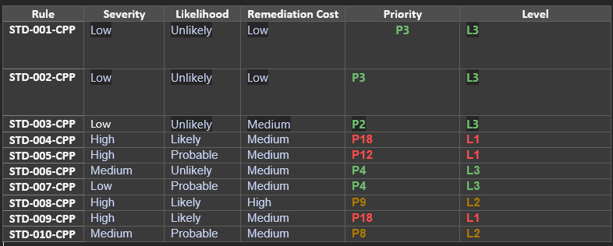
CODING STANDARDS
Memory Access (STD-009)
SQL Injection (STD-004)
Memory Protection (STD-005)
Container Indices (STD-008)
Freeing Memory (STD-010)
Assertions (STD-006)
Exceptions (STD-007)
Data Type (STD-001)
Data Value (STD-002)
String Correctness (STD-003)
Notes:
Here are the 10 coding standards. Looking at the risk assessment, I have ranked them based on severity and prioritization. It goes from Memory Access, SQL Injection, and Memory Protection having the highest severity. Then Container indices and Freeing Memory. Assertions and Exceptions. And Lately, Data Type, Value, and String Correctness. By addressing higher priory standards first, we are preventing more severe outcomes from happening.

Slide 6
ENCRYPTION POLICIES
Encryption at Rest
Secure disks in protected areas.
Encrypt data using industry standard algorithms
Encryption at Flight
Follow the principle of least privilege
Network should be secured with authentication or firewall
Encryption in Use
Include various forms of input validation
Identify roles to control access
Include logs to track access and changes
Provide proper infrastructure to limit avenues of attack
Notes:
To ensure that our data is protected in all states, we have laid out some encryption policies for when data is at rest, in flight, and in use. While at rest, we will ensure that our physical disks are stored in a proper and secure location. They should also be encrypted with industry standard algorithms such as AES-256. While in flight we should follow the principle of least privilege and limit the access someone has to the data. The network that is sending and retrieving the data should also be secured through authentication or a firewall. Data in use should include various forms of input validation to prevent SQL injection attacks. We should also define roles for people to quickly establish what access they have. Whether they are a user or administrator. Along with that, data should be logged and monitored to catch any suspicious activities. Lastly, a proper system infrastructure is important for data protection in all these phases.

Slide 7
TRIPLE-A POLICIES
Authentication
How we determine someone’s identity
Helps protect user’s account
Can be done through username-password in addition to two-way authentication
Authorization
Process of giving permission or access to users through roles
Embodies principle of least privilege to limit access
Only allow authorized roles to perform certain tasks
Accounting
How we monitor activities within the system
Done though activity logs
Helps identify suspicious activities, where it is happening, and by who
Notes:
Triple-A policies are how we can Authenticate, Authorize, and Account for all activity within the system. Authentication is how we determine someone’s identity. This is most typically done through a username and password. This can be further improved on with the addition of two-way authentication. By doing this, it secures the user’s account and prevents unauthorized access. Authorization is the next policy. This is the process of giving permission and access to roles. It is the embodiment of the principle of least privilege and limits the amount of access given to someone. This prevents giving too much access making them more susceptible to attacks. Lastly, we have accounting. This is how we monitor activities that are going on in the system. My logging these activities, we can more easily identify if suspicious activities are happening and track where and who is performing it.

Slide 8
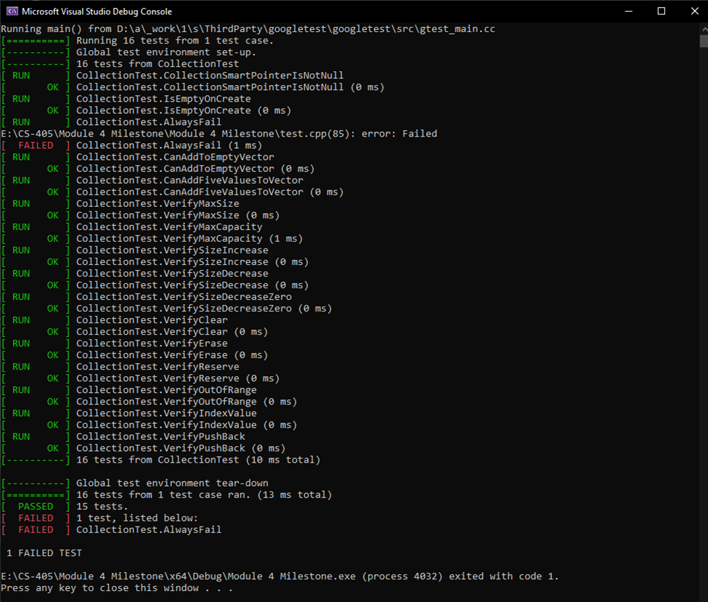
Unit Testing
How we test the functionality of individual components
The examples will be testing for vulnerabilities dealing with STD-002 Data Value and STD-005 Memory Protection
This will be done using the GoogleTest library
Notes:
Unit testing is how we test individual components of the program to ensure that it is working correctly against all parameters. At Green Pace we will use GoogleTest as our testing library.

Slide 9
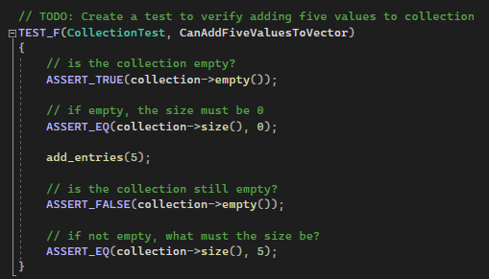
Test 1: Adding 5 values to a collection
Test that collection is empty with size being 0
Adding 5 entries
Test that new collection size is now 5
Notes:
Our first test, we are testing the functionality of adding 5 entries to a collection. This is done by us asserting that the collection is indeed empty and its size is 0. We then add 5 entries into the collection and test that the collection should not be empty anymore. We then asserted that the collection size should now be 5.

Slide 10
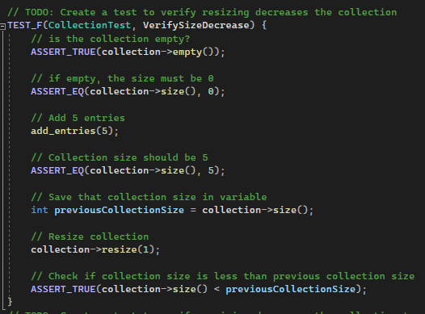
Test 2: Verify Size Decrease
Set collection default to being empty and of size 0
Add 5 entries and verify size change
Save this size in a previous size variable
Resize the collection to a size of 1
Assert true that collection size now is smaller than the previous collection size
Notes:
This next test is to verify a size decrease functionality. This was done by setting a base collection to be empty and of size 0. We then add 5 entries and save the collection size in a variable. We then resized the collection to 1. This was now tested to assert true that the collection size now is smaller than the previous collection size.

Slide 11
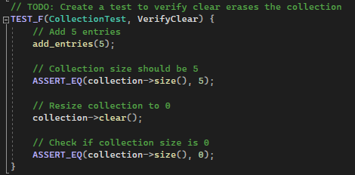
Test 3: Verify Clear
Add 5 entries into a collection
Verify that the collection size is now 5
Perform a clear on that collection
Confirm that the collection size is now 0
Notes:
Next, we verify a clear function. We begin by adding 5 entries into the collection and confirming that the collection size is now 5. We will then perform a clear on that collection and assert that the collection size is now 0.

Slide 12
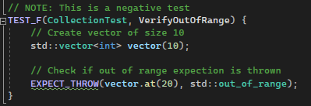
Test 4: Out of Range
Create a vector of size 10
Expect an out-of-range throw if we try to access an index on the vector that is not in range
Negative test
Notes:
The last test will be a negative test in which we will provide invalid data and expect it to be caught. This will be an out-of-range test which will begin by initializing a vector of size 10. We then expect an out-of-range throw if we try to access the vector at index 20.

Slide 13

AUTOMATION SUMMARY
Notes:
Security has been shown to be a critical part in the software development process. Luckily, there are several ways we can automate this process through a DevSecOps pipeline.

Slide 14
TOOLS
The DevSecOps pipeline is the integration of security within the typical DevOps.
Begins with planning through a security policy
Unit testing
Frequent maintenance
Tools:
CppChecker, GitLab, Docker
Notes:
The DevSecOps pipeline is the integration of security within the typical DevOps. This follows the statement of “not leaving security till the end”. This begins with the access and planning phase in which we will create a security policy of standards to abide by. This also gives us a chance to perform threat modeling and identify potential risks before they occur. Unit testing should be implemented throughout the development process by testing every component to ensure that it is working as intended. This spans to the end of development where we should be diligent at maintaining the software and neutralize any bugs that might occur.
Notable tools that can be used are CppChecker which provides a more in depth examination of compiler warnings and errors. GitLab for enable productive collaboration, and Docker to create containers for each component of the system.

Slide 15
RISKS AND BENEFITS
Security should be implemented at all stages of the software development process
Bugs and vulnerabilities will continue to grow as it is ignored
Makes it extremely difficult to find and fix the error
Earlier a bug is caught, the faster and easier time it takes to fix
By ignoring security, you run the risk of having a breach at any moment.
Ex: Yahoo (2013), LinkedIn (2021)
Notes:
Security should be implemented at all stages of the development process. By leaving it till the end, we leave bugs the ability to slowly grow and build on top of each other. This results in it being extremely difficult to locate and fix the source of error. When we ignore security, we run the risk of having a breach at any moment. And once it does, damage will be done such as what happened with Yahoo’s and LinkedIn’s breach where they lost millions. By spending a little on preventative measures, we can stop the loss of millions and preserve the trust of our clients.

Slide 16
RECOMMENDATIONS
Putting an emphases on cloud computing
ex: AWS, Azure
Cloud has built-in security protocols that are managed by third parties
Server maintenance is performed by the provider
Lower upfront costs as opposed to purchasing physical storage or servers
Notes:
Although our security policy is quite inclusive there are some recommendations, I would like to add to further improve on it. For one, I would like to put an emphasis on cloud computing such as AWS or Azure. This is because it enables us to push much of the server maintenance onto a third party leaving us more room to focus on coding. Along with that, it can also be financially feasible as we will only be paying for what we use.

Slide 17
CONCLUSIONS
Create a security policy to abide by
Train developers how to identify risks and how to properly nullify it
Look into integrating with the cloud
Notes:
In conclusion, we have identified the importance of security. A security policy is a great way to set standards for how security should be implemented and caught. He helps streamline what we should look for within our program and how we should solve it. My continuing to improve on it such as cloud integration and its features we solidify the future of Green Pace.

Slide 18
REFERENCES
Froehlich, A. (2022, July 28). How to secure data at rest, in use and in Motion. Security. https://www.techtarget.com/searchsecurity/feature/Best-practices-to-secure-data-at-rest-in-use-and-in-motion
Swinhoe, M. H. and D. (2022, November 8). The 15 biggest data breaches of the 21st Century. CSO Online. https://www.csoonline.com/article/2130877/the-biggest-data-breaches-of-the-21st-century.html
Notes:
Thank you for listening. I hope this presentation gave you a good insight at Green Pace’s new security policy and to the importance of security in general

